Slide 1
Summer Training Project
Topic:
English Premiere League 2019-2020
(Tableau Project)
By:
MOHAMMED AMJAD
LOVELY PROFESSIONAL UNIVERSITY
amjadkooriyad@gmail.com
9567025475

Slide 2
Introduction
This project give the information about the English Premiere League in a period of 2019-2020 .From the data we analyze about the each team performance through various parameter . From that we can analyze and find about the form of each which help to predict which team will win. Also we can find which team is most aggressive one in ground and which team can play high tactical game. The winning majority also ensure about the manager tactical skill which help the players and team to improve themselves but we want to find how it helped them?

Slide 3
Problem Statement:
Based on full analysis UEFA(Union of European football Association) want to find the some best players of the season and they want to congrats players by giving awards . Different type of awards categories are : Uefa best player of 2019 , Uefa Best playmaker , Uefa best Defender , Uefa best Goal keeper.
1.Player with most assist?
2. Team with most number of clean sheets?
3. Most goal conceded team?
4. Player with most Yellow and red cards?
5. Each Team Total point?
6.Player with most clean sheets?
7.Which player have high creativity point(playmaking skill) ?
8.Most goal Scored team?
9.Which player played highest amount of total minutes in this season?
10. Player with Most number of saves(Goal keeping skill)?
11. Number of goal and assist high in which month?
12. Player with most number of goals?
?

Slide 4
Solution for problem statement:
Analyzed report

Slide 5
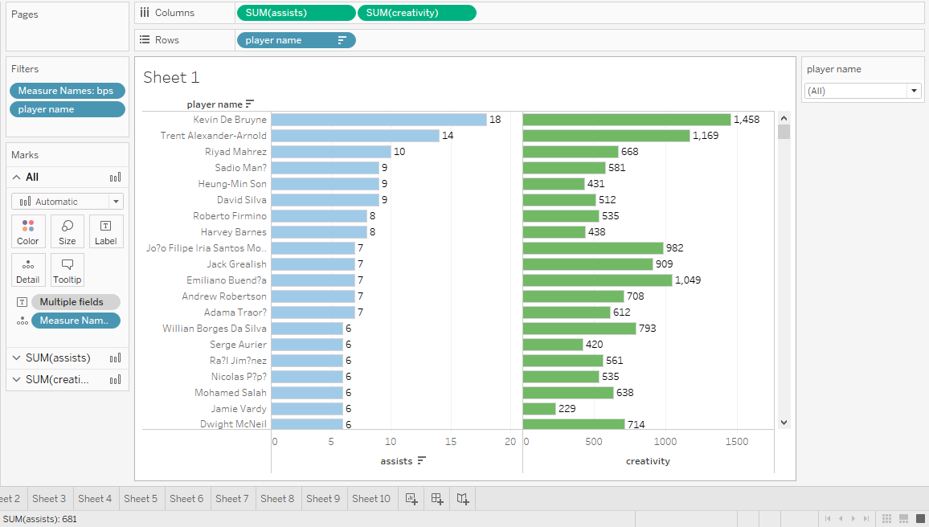
*Player with most assist?
*Which player have high creativity point(playmaking skill) ?
Kevin de bruyne is the Best playmaker.

Slide 6
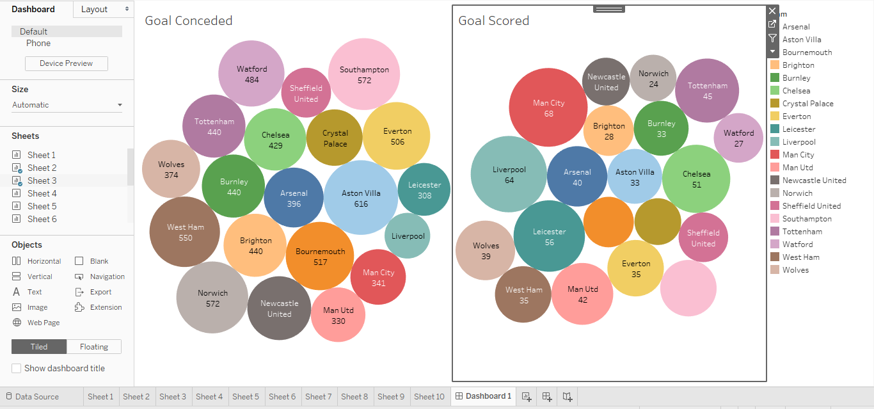
*Most goal conceded team?
*Most goal Scored team?
Basket have high discount
Most Goal Scored Team : Manchester City(68)
Most Goal Conceded Team : Aston villa(616)

Slide 7
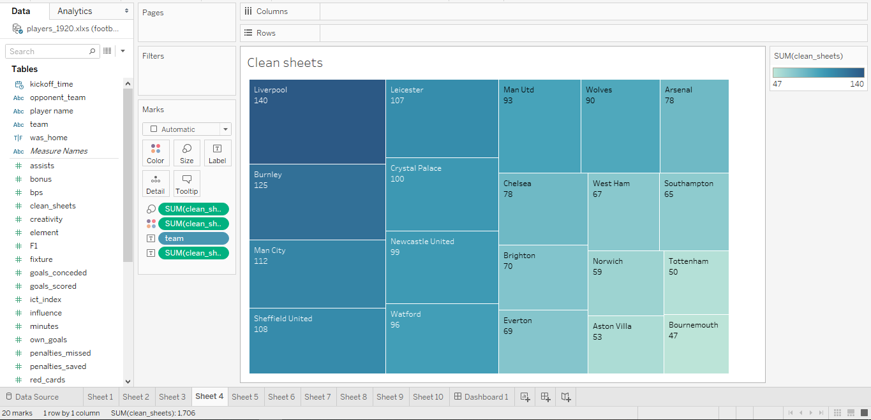
*Team with most number of clean sheets?
Liverpool have most number of clean sheets

Slide 8
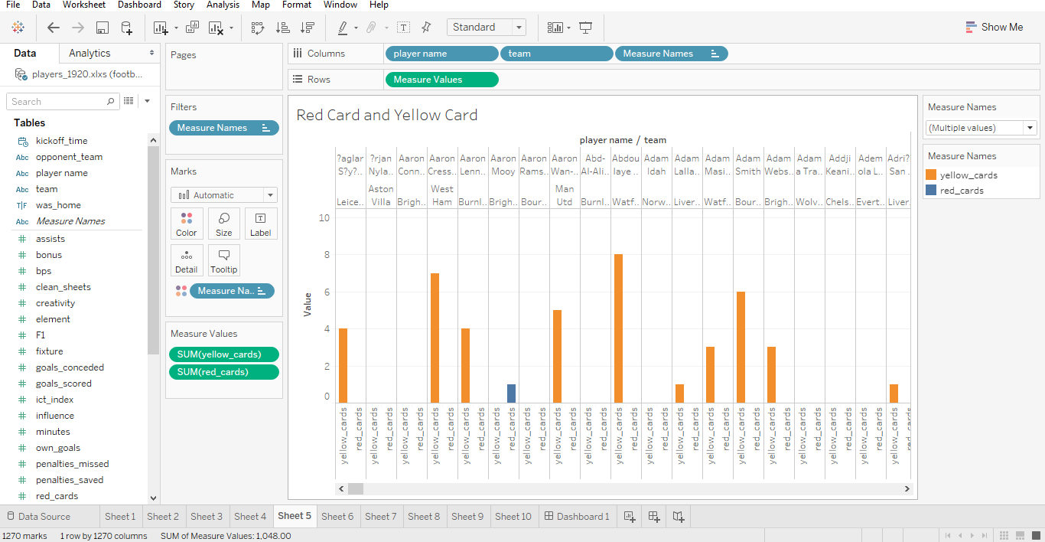
*Player with most Yellow and red cards?
Red card : Aron mooy (Brighton)
Yellow card :Roman sass (wolves)

Slide 9
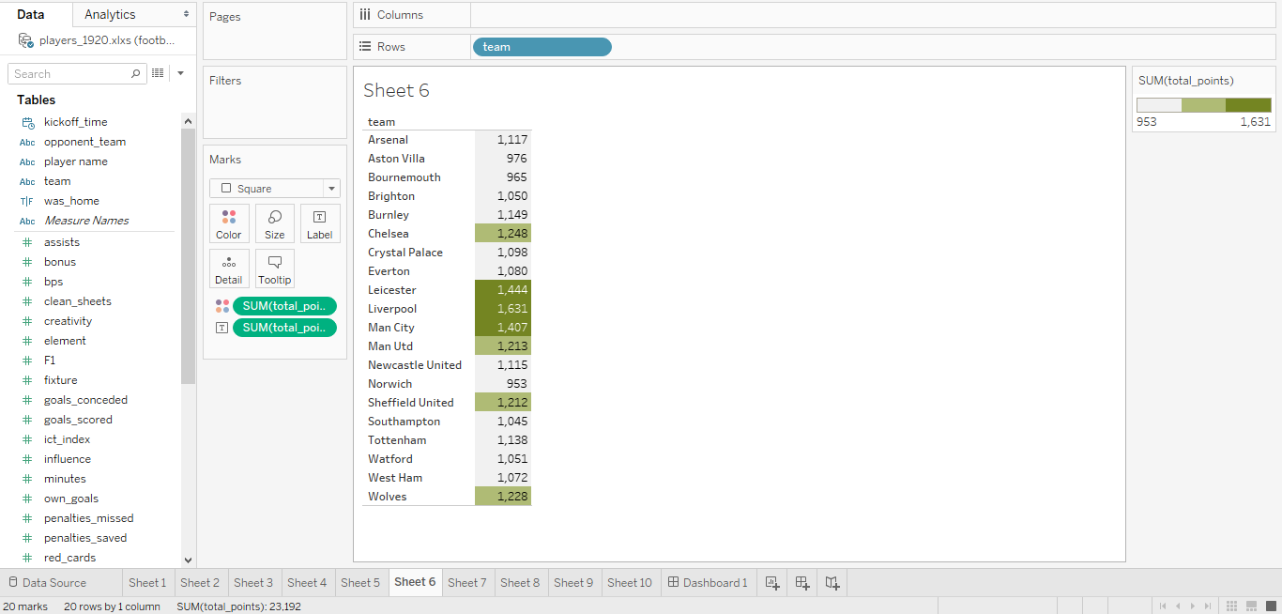
*Each Team Total point?
Liverpool have highest point
Norwich have lowest point

Slide 10
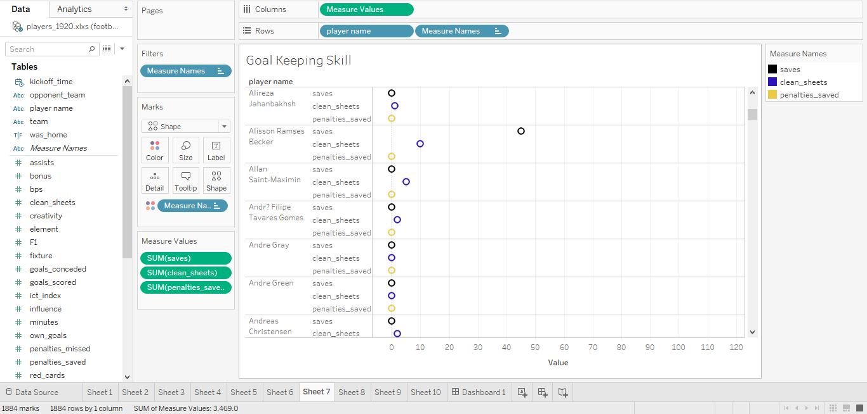
*Player with Most number of saves(Goal keeping skill)?
*Player with most clean sheets?
Alison Becker is the Best Goalkeeper

Slide 11
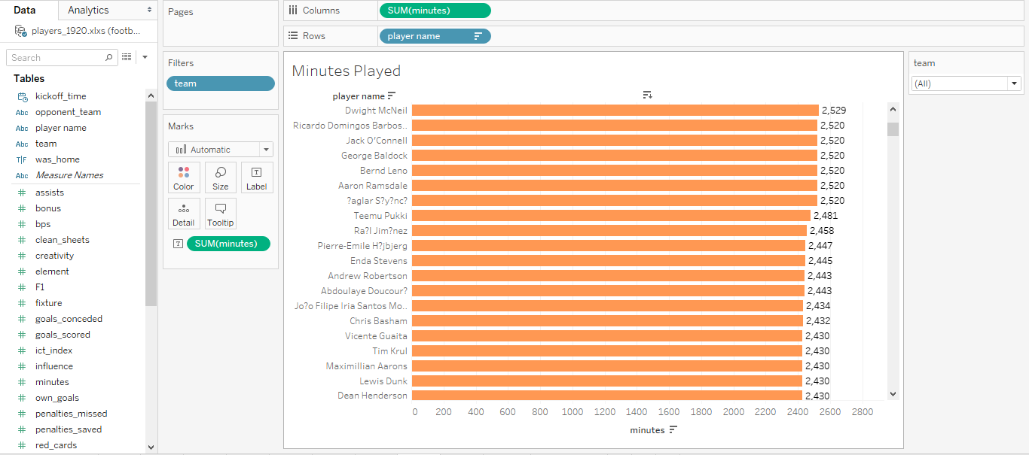
*Which player played highest amount of total minutes in this season?
Dwight Mcnell played most in this season

Slide 12
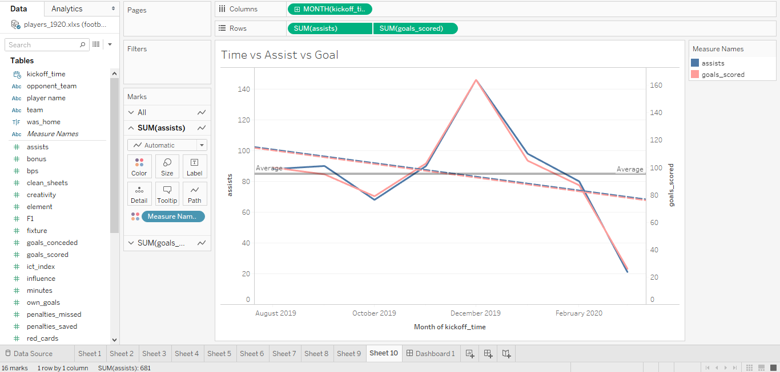
*Number of goal and assist high in which month?
December have maximum goal and assist

Slide 13
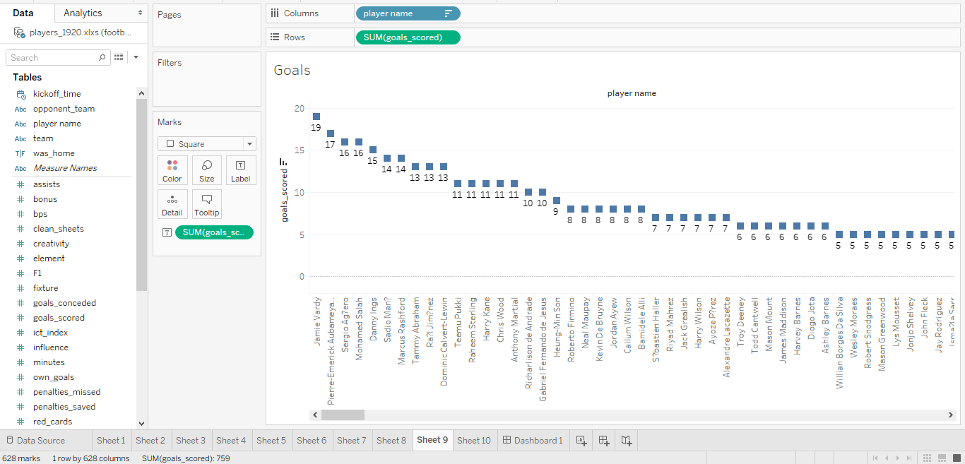
*Player with most number of goals?
Jamie vardy is the top scorer

Slide 14
Conclusion
From the analysis we found who is the best player , best playmaker ,best goalkeeper
Best Player: Virgin van digik
Best Playmaker : kevin de bruyno
Best goal keeper : Alison Becker
Top Goal scorer : Jamie vardy
Best Defender : virgin van digik
Best Team : Liverpool

Slide 15
Reference :
Data : English Premier League 2019-2020 : www.kaggle.com
www.google.com
www.youtube.com
Project video:
YouTube video link: https://youtu.be/AOd0-kwGEuA
Tableau Public link : https://public.tableau.com/profile/mohammed.amjad#!/

